Slide 1
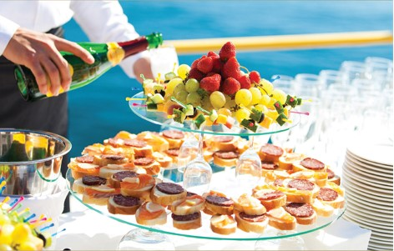


Chapter 7
Building and maintaining customer relationships
Introduction to customer service
© Hudson & Hudson. Customer Service for Hospitality & Tourism 3rd edn

Slide 2
Topics Covered
Relationship Marketing
Retention Strategies
Loyalty programs
Benefits of Relationship Marketing
Targeting profitable customers

Slide 3
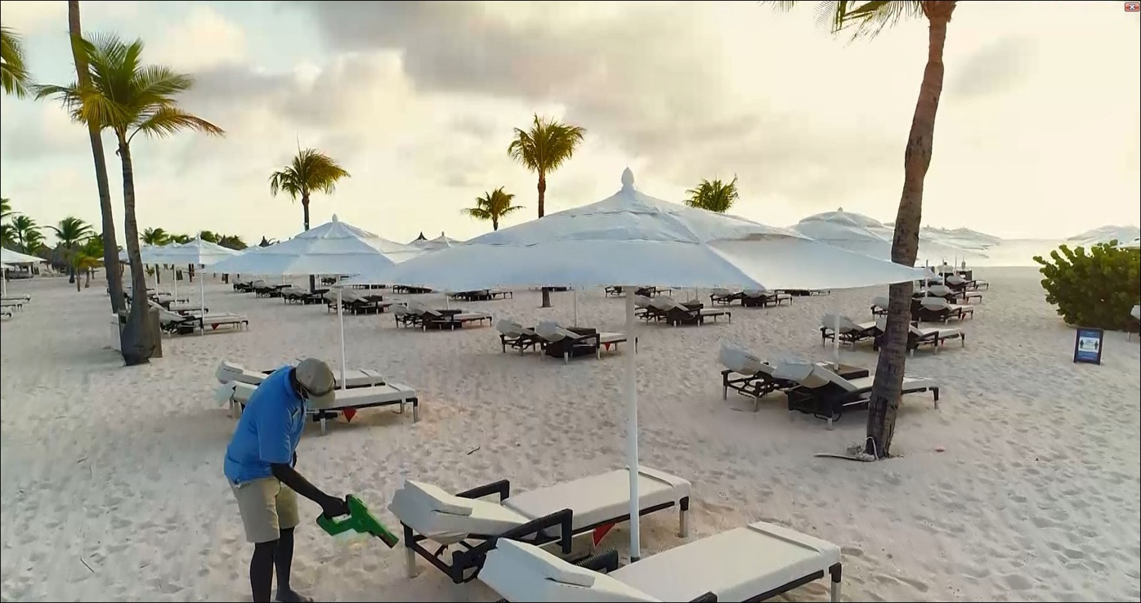
‘At Your Service’ Spotlight:
Developing loyal customers post- pandemic at Bucuti & Tara in Aruba
A hotel in Aruba that has always been ahead of the innovation curve
One of the few hotels that never closed its doors completely in 2020, and during the lockdown, played host to stressed-out frontline workers.
When Aruba’s borders did reopen, were quick to adapt, introducing new procedures, policies and protocols to protect the safety of guests and staff.
Rooms were as clean as a hospital operating room.
“This new way of living and travel is here, and those who will endure will embrace it by ensuring their property is safe and healthy for both their guests and staff.”

Slide 4
Relationship marketing
A form of marketing that attracts customers,
retains them, and enhances their satisfaction.
Less expensive to attract repeat customers
Dramatic increases in profits
  Repeat customers generate twice as much gross income as new customers
Enhancing customer satisfaction includes:
  Nurturing individual relationships
  Making customers feel unique
  Making customers feel singled out for attention
  Loyalty programs

Slide 5
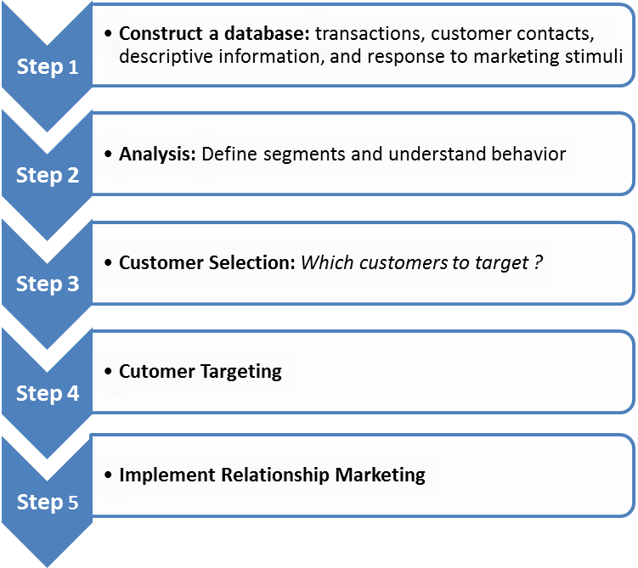
Customer Relationship Management Model
Figure 7.1 (Source: Based on Winer, 2001)

Slide 6
Levels of retention strategies
Figure 7.2 (Source: Adapted from Zeithaml and Bitner, 2000)

Slide 7
Loyalty programs
Extremely common in hospitality and tourism
Customized reward programs are growing
Coalition model is also more common
Airlines
  Frequent flyer rewards
  Highest fare holders
  Elite status customers
Hotels
  Complimentary meals, internet access
  Included in franchise fees
  Joint programs for smaller brands, boutique hotels
Restaurants
  Rewards Cards
  Non-financial incentives e.g. ‘Jump the Line’ perk
Notes:
Loyalty programs
Extremely common in hospitality and tourism
Customized reward programs are growing
Coalition model is also more common
Airlines
Frequent flyer rewards
Highest fare holders
Elite status customers
Hotels
Complimentary meals, internet access
Included in franchise fees
Joint programs for smaller brands, boutique hotels
Restaurants
Rewards Cards
Non-financial incentives e.g. ‘Jump the Line’ perk

Slide 8
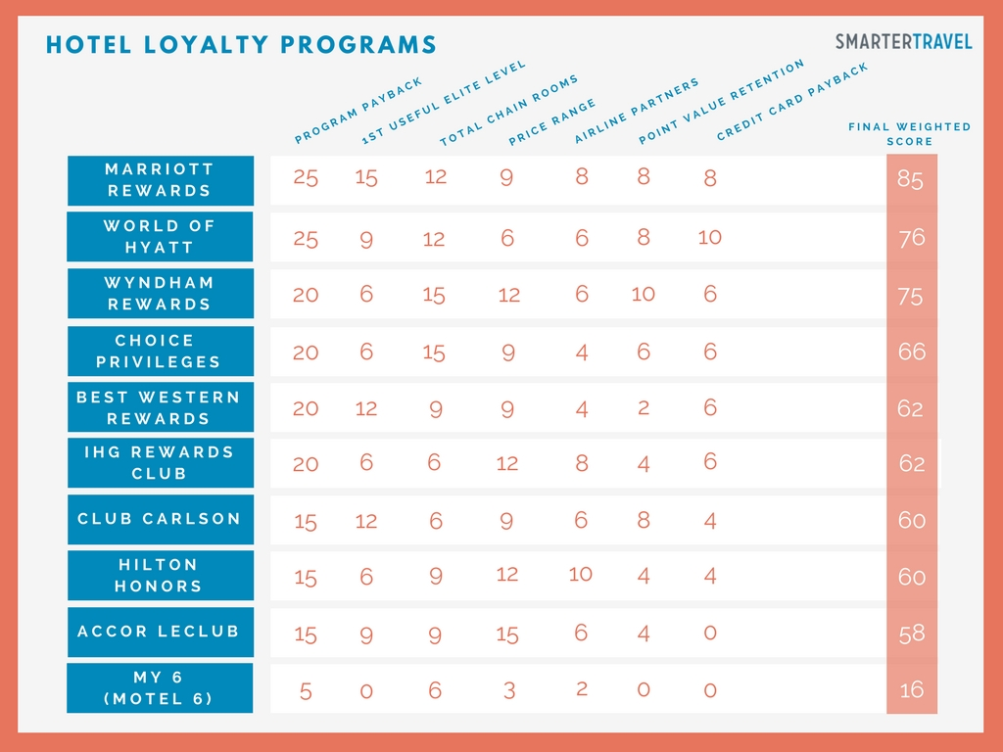

Slide 9
Service loyalty classification scheme
Figure 7.3 (Source: Adapted from Dick and Basu, 1994)

Slide 10
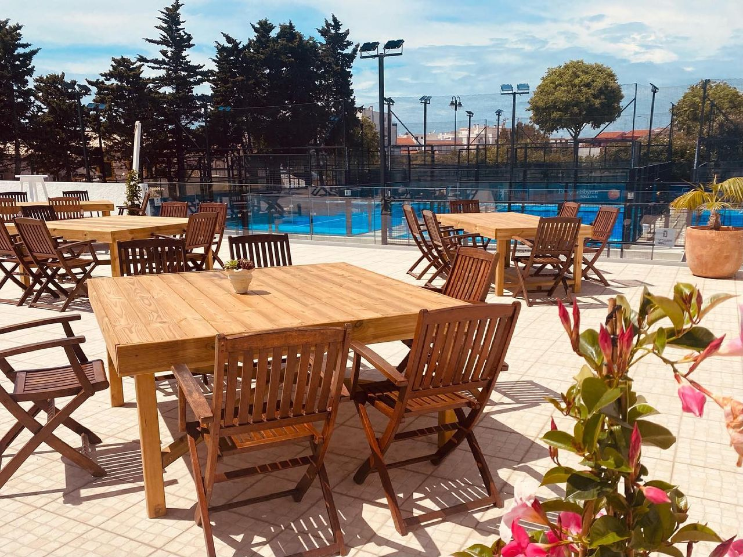
Snapshot:
Spotting a pandemic opportunity
“We focus on exemplary standards. Whether it is equipment or service, food or drinks, everything is served with flair.”
Spotting an opportunity in the middle of a pandemic, former catering and events entrepreneur, John Hill opened a restaurant and bar next door to a padel center in Portugal.
“Because of the pandemic, we were never sure what would happen next, so we have grown organically”
Relies on positive word of mouth to bring business to his restaurant.
Hill admits that he wouldn’t have taken the restaurant on without the padel courts. “The center is now an important part of the community, and most of our customers are regulars here – tourists are a bonus!”

Slide 11
Benefits of Relationship Marketing
Customers loyalty incentives:
  High perceived value
  ‘Get’ should exceed ‘Give’
  Rewards for loyalty
Company benefits:
  Higher profits through retaining customers
    More purchases overall
    More frequent purchases
  Lowers operating costs
    No acquisition costs
  Increases company referrals

Slide 12
Benefits of relationship marketing
Table 7.2

Slide 13
Targeting profitable customers
Building and improving upon traditional segmentation
Studying loyalty- versus defection-prone customers
  Identify profitability bands
  Identify customers most likely to remain loyal
  Develop overall strategy around these customers
    Target with retention strategies
  Other customers too costly to retain
    Little potential to become profitable

Slide 14
The 80/20 customer pyramid
Figure 7.4 (Source: Adapted from Zeithhaml and Bitnen, 2000)
Notes:
S

Slide 15
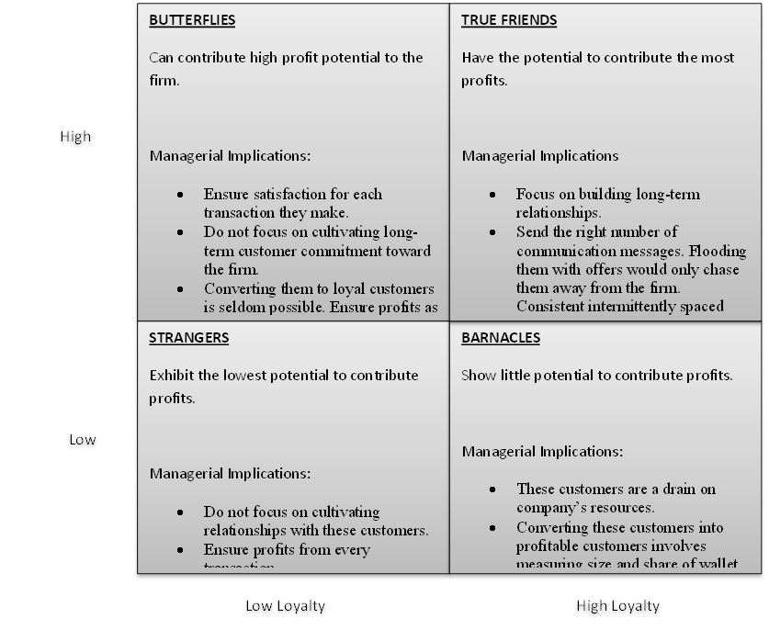
Managing loyalty and profitability
Figure 7.5 (Source: Adapted from Kumar and Rajan, 2009, p. 5)

Slide 16
A taxonomy of casino customer segments
Figure 7.6 (Source: Watson and Kale, 2003)

Slide 17
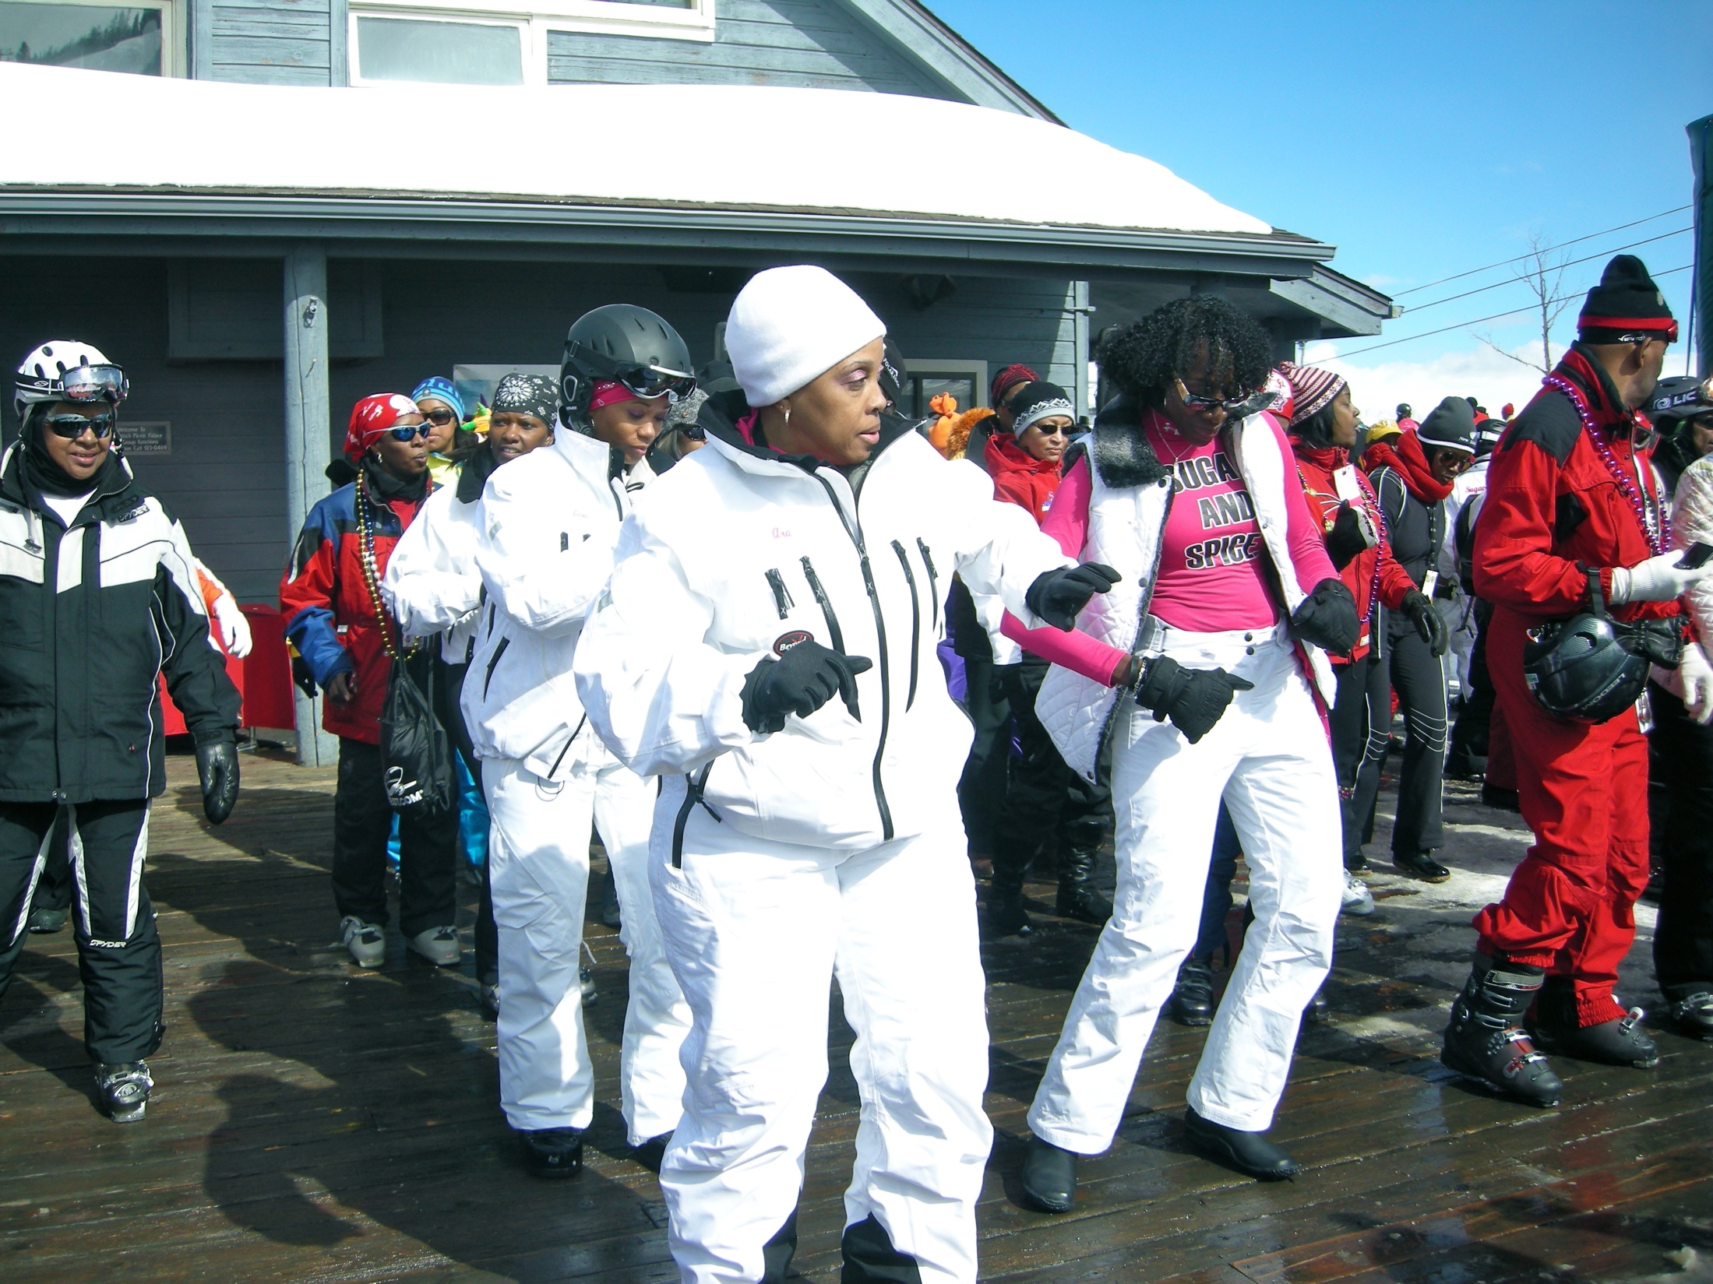
Case Study: African-American travelers – an increasingly profitable market
African-American travel market is the third fastest growing segment in the US travel sector
African-Americans travel most frequently for leisure purposes (79%), especially to visit friends and relatives, and they tend to travel most frequently in the Southern states.
The quality of service and quality of accommodation are their top two priorities
Providers have been slow in targeting this segment but some have spotted the opportunity:
  Embassy Suites and Homewood Suites by Hilton
  Destinations hosting the National Brotherhood of Skiers (NBS)

